Slide 1
Luke’s Eye-witness Accounts in Acts

Slide 2
Nature of New Testament
27 Books
9 Authors:
Matthew
Mark
Luke
John
Paul
Author of Hebrews
James
Peter
Jude

Slide 3
Provenance
Mainly Jewish authors, except Luke
Latter half of 1st century
Written on papyrus scrolls
May have been written for local needs
Independently copied and distributed
Both interdependent and independent
Competed with forgeries
Canon finalised in 4th Century

Slide 4
“We” Passages in Acts
Sections in Acts | Description | Approximate Dates
16:10 to 16:18 | Troas to Philippi | 49 AD
20:6 to 21:19 | Philippi to Jerusalem | 54 to 57 AD
27:1 to 28:30 | Caesarea to Rome | 59 AD to 62 AD

Slide 5
Troas to Philippi (Acts 16:6-10)
6 Paul and his companions travelled throughout the region of Phrygia and Galatia, having been kept by the Holy Spirit from preaching the word in the province of Asia.
7 When they came to the border of Mysia, they tried to enter Bithynia, but the Spirit of Jesus would not allow them to.
8 So they passed by Mysia and went down to Troas.
9 During the night Paul had a vision of a man of Macedonia standing and begging him, "Come over to Macedonia and help us."
10 After Paul had seen the vision, we got ready at once to leave for Macedonia, concluding that God had called us to preach the gospel to them.

Slide 6
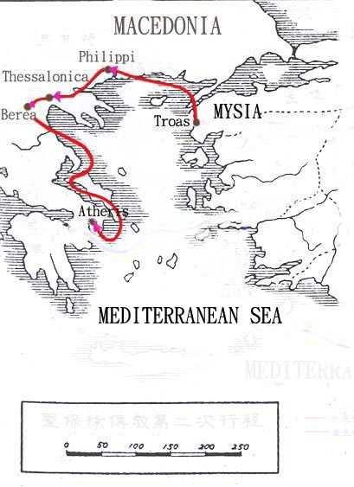
Troas to Philippi
Luke picked up at Troas
Left at Philippi
Paul in Corinth for 18 months
Ephesus for 2 years
We passages stop for at least 4 years
Then Paul revisits Philippi

Slide 7
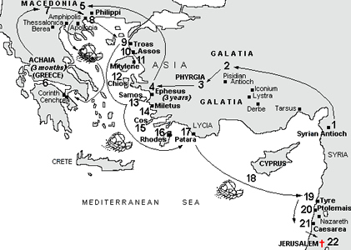
Luke travels to Jerusalem (points 8 to 22)

Slide 8
Arrival at Jerusalem
When we arrived at Jerusalem, the brothers received us warmly. The next day Paul and the rest of us went to see James [Jesus’ brother], and all the elders were present.” (Acts 21: 17,18)

Slide 9
Paul in prison at Caesarea
Paul performs vow at temple
There is a riot and Paul is arrested
Paul imprisoned for 2 years in Caesarea (57 to 59 AD)
“We” passages stop during this time
Where was Luke during this time?

Slide 10
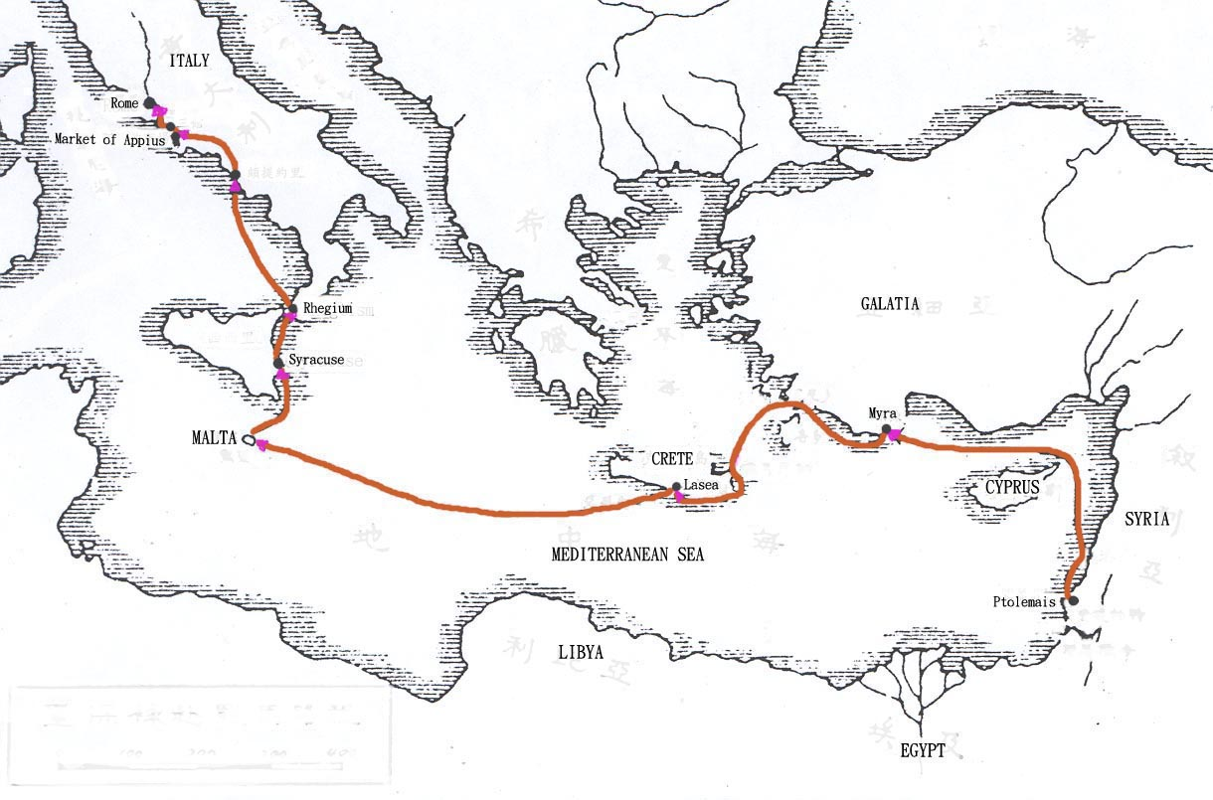
Sea Voyage Caesarea to Rome
Paul sent to Rome
“We” passages recommence
We, we, we – all the way to Rome

Slide 11
Acts 27
Sea voyage from Caesarea to Malta
Note details regarding the places they visited and the details regarding the ship
Is this an eyewitness account?

Slide 12
The Sea Voyage (Acts 27)
27 When it was decided that we would sail for Italy, Paul and some other prisoners were handed over to a centurion named Julius, who belonged to the Imperial Regiment. 2 We boarded a ship from Adramyttium about to sail for ports along the coast of the province of Asia, and we put out to sea. Aristarchus, a Macedonian from Thessalonica, was with us.
3 The next day we landed at Sidon; and Julius, in kindness to Paul, allowed him to go to his friends so they might provide for his needs. 4.

Slide 13
The Sea Voyage (Acts 27)
4 From there we put out to sea again and passed to the lee of Cyprus because the winds were against us. 5 When we had sailed across the open sea off the coast of Cilicia and Pamphylia, we landed at Myra in Lycia. 6 There the centurion found an Alexandrian ship sailing for Italy and put us on board. 7 We made slow headway for many days and had difficulty arriving off Cnidus. When the wind did not allow us to hold our course, we sailed to the lee of Crete, opposite Salmone. 8 We moved along the coast with difficulty and came to a place called Fair Havens, near the town of Lasea.

Slide 14
The Sea Voyage (Acts 27)
9 Much time had been lost, and sailing had already become dangerous because by now it was after the Fast. So Paul warned them, 10 "Men, I can see that our voyage is going to be disastrous and bring great loss to ship and cargo, and to our own lives also." 11 But the centurion, instead of listening to what Paul said, followed the advice of the pilot and of the owner of the ship. 12 Since the harbor was unsuitable to winter in, the majority decided that we should sail on, hoping to reach Phoenix and winter there. This was a harbor in Crete, facing both southwest and northwest.

Slide 15
The Sea Voyage (Acts 27)
13 When a gentle south wind began to blow, they thought they had obtained what they wanted; so they weighed anchor and sailed along the shore of Crete. 14 Before very long, a wind of hurricane force, called the "northeaster," swept down from the island. 15 The ship was caught by the storm and could not head into the wind; so we gave way to it and were driven along. 16 As we passed to the lee of a small island called Cauda, we were hardly able to make the lifeboat secure.

Slide 16
The Sea Voyage (Acts 27)
17 When the men had hoisted it aboard, they passed ropes under the ship itself to hold it together. Fearing that they would run aground on the sandbars of Syrtis, they lowered the sea anchor and let the ship be driven along. 18 We took such a violent battering from the storm that the next day they began to throw the cargo overboard. 19 On the third day, they threw the ship's tackle overboard with their own hands. 20 When neither sun nor stars appeared for many days and the storm continued raging, we finally gave up all hope of being saved.

Slide 17
The Sea Voyage (Acts 27)
21 After the men had gone a long time without food, Paul stood up before them and said: "Men, you should have taken my advice not to sail from Crete; then you would have spared yourselves this damage and loss. 22 But now I urge you to keep up your courage, because not one of you will be lost; only the ship will be destroyed. 23 Last night an angel of the God whose I am and whom I serve stood beside me 24 and said, 'Do not be afraid, Paul. You must stand trial before Caesar; and God has graciously given you the lives of all who sail with you.' 25 So keep up your courage, men, for I have faith in God that it will happen just as he told me. 26 Nevertheless, we must run aground on some island."

Slide 18
The Sea Voyage (Acts 27)
27 On the fourteenth night we were still being driven across the Adriatic Sea, when about midnight the sailors sensed they were approaching land. 28 They took soundings and found that the water was a hundred and twenty feet deep. A short time later they took soundings again and found it was ninety feet deep. 29 Fearing that we would be dashed against the rocks, they dropped four anchors from the stern and prayed for daylight. 30 In an attempt to escape from the ship, the sailors let the lifeboat down into the sea, pretending they were going to lower some anchors from the bow. 31 Then Paul said to the centurion and the soldiers, "Unless these men stay with the ship, you cannot be saved." 32 So the soldiers cut the ropes that held the lifeboat and let it fall away.

Slide 19
The Sea Voyage (Acts 27)
33 Just before dawn Paul urged them all to eat. "For the last fourteen days," he said, "you have been in constant suspense and have gone without food — you haven't eaten anything. 34 Now I urge you to take some food. You need it to survive. Not one of you will lose a single hair from his head." 35 After he said this, he took some bread and gave thanks to God in front of them all. Then he broke it and began to eat. 36 They were all encouraged and ate some food themselves. 37 Altogether there were 276 of us on board. 38 When they had eaten as much as they wanted, they lightened the ship by throwing the grain into the sea.

Slide 20
The Sea Voyage (Acts 27)
39 When daylight came, they did not recognize the land, but they saw a bay with a sandy beach, where they decided to run the ship aground if they could. 40 Cutting loose the anchors, they left them in the sea and at the same time untied the ropes that held the rudders. Then they hoisted the foresail to the wind and made for the beach. 41 But the ship struck a sandbar and ran aground. The bow stuck fast and would not move, and the stern was broken to pieces by the pounding of the surf.

Slide 21
The Sea Voyage (Acts 27)
42 The soldiers planned to kill the prisoners to prevent any of them from swimming away and escaping. 43 But the centurion wanted to spare Paul's life and kept them from carrying out their plan. He ordered those who could swim to jump overboard first and get to land. 44 The rest were to get there on planks or on pieces of the ship. In this way everyone reached land in safety.

Slide 22
Completion of Acts
30 For two whole years Paul stayed there in his own rented house and welcomed all who came to see him. 31 Boldly and without hindrance he preached the kingdom of God and taught about the Lord Jesus Christ.

Slide 23
What happened afterwards?
Event | Approximate Date
Paul’s trial | After 62 AD
Neronian persecutions | 64 AD
Paul, Peter & James executed | Mid 60s
Jewish Wars | 66-70 AD
Destruction of Jerusalem | 70 AD
Why didn’t Luke mention these things?

Slide 24
Luke’s Prologue
1 Many have undertaken to draw up an account of the things that have been fulfilled among us, 2 just as they were handed down to us by those who from the first were eyewitnesses and servants of the word. 3 Therefore, since I myself have carefully investigated everything from the beginning, it seemed good also to me to write an orderly account for you, most excellent Theophilus, 4 so that you may know the certainty of the things you have been taught.

Slide 25
Key Points in Prologue
5 points:
Luke consulted prior writings
He spoke to eyewitnesses
He conducted a careful investigation
He wrote an orderly account
So that the reader may have certainty
When did he do this?
Jerusalem (57-59 AD)?

Slide 26
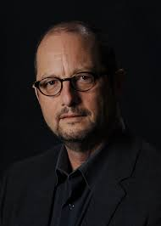
Theories on We passages
Genuine historical witness
Redactor
Stylistic Convention
Fraudulent contrivance (Bart Ehrman)

Slide 27
Early Christian Writings
This nonchalant and matter-of-fact dovetailing convinces me that the author of Acts was among those who were left behind at Philippi and joined up with Paul to sail from there later. The distinction between Paul and "us" discredits the idea that the first person perspective in these passages is some kind of literary device, which would take the perspective of Paul (for example increasing the drama of Paul's adventure or increasing the connection of Paul to the group), and for which there is no precedent in ancient literature. The alternative is that the author of Acts was making a false affectation to being a companion of Paul.

Slide 28
Early Christian Writings (cont)
This prompts the question of why the author made this claim in such a subtle way, instead of ensuring that the reader could not miss it by emphasizing the point, as apocryphal writers often did. It also leaves us wondering as to why the false claim to participation is restricted to a few passages, leaving Paul alone for most of the narrative--though this is understandable if the author's participation was in fact sporadic. The most probable conclusion is that Luke had travelled with Paul at times, a fact of which Luke's patron Theophilus was already aware.

Slide 29
Summary
It seems likely that:
The author (most probably Luke) accompanied Paul occasionally from 49 to 62 AD
Luke had contact with key eyewitnesses in Jerusalem between 57 & 59 AD
This included Jesus’ family and key witnesses
Luke used the gospel of Mark
What does this mean for the dating of Mark?

Slide 30
Last Words
Luke concludes with house arrest
2 Timothy written after 1st defence
Paul chained in Roman prison
Death imminent
“Only Luke is with me”

Slide 31
Irenaeus - Against Heresies
Luke also, the companion of Paul, recorded in a book the gospel preached by him [meaning Paul].

Slide 32
Fellowship across time
Luke is subtle in the way that he identifies his personal involvement
We can still perceive his personality and identify with him
We proclaim to you what we have seen and heard, so that you may also have fellowship with us. And our fellowship is with the Father and with his Son, Jesus Christ. We write this to make our joy complete. (1 John 1:3)
Read Luke’s writings again with new eyes!

Slide 33
References
Acts and Luke
http://en.wikipedia.org/wiki/Authorship_of_Luke%E2%80%93Acts
http://www.earlychristianwritings.com/acts.html

