Slide 1
^{Does god exist?}

Slide 3
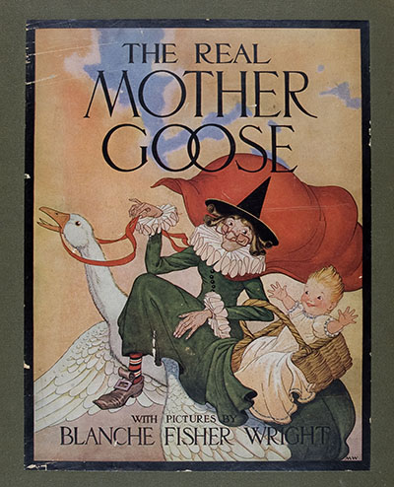
“I don’t believe in god because I don’t believe in Mother Goose.”
Clarence Darrow 1930

Slide 4
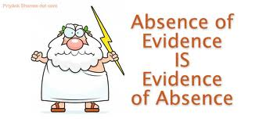
No actual evidence of the existence of any gods!

Slide 5
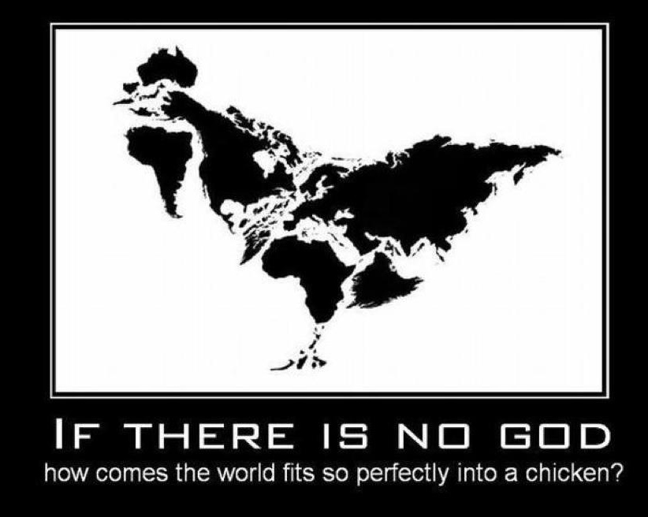
The evidence cited by believers is indirect and subjective!

Slide 6
Believers claim nature’s beauty gives evidence of god’s existence …

Slide 7
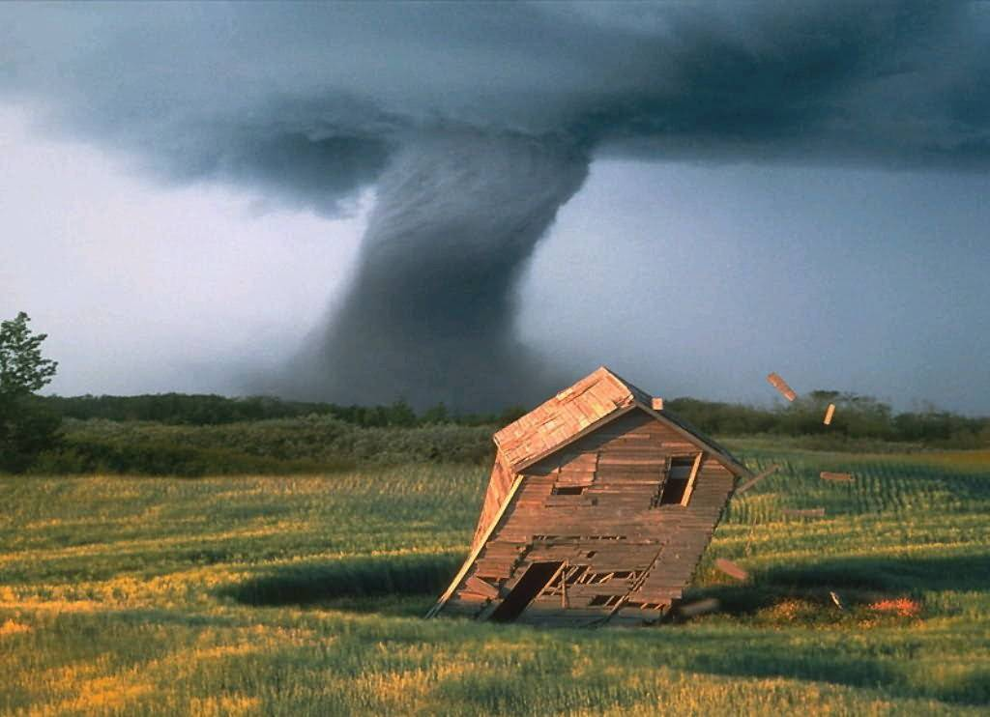
… conveniently ignoring the fact that nature can also be very destructive!

Slide 8
If, as some claim, god does exist, to which god are they referring?

Slide 10
3700 Supernatural Beings;
2670 DEITIES!

Slide 11
So, which of these “supernatural beings” might be REAL?

Slide 12
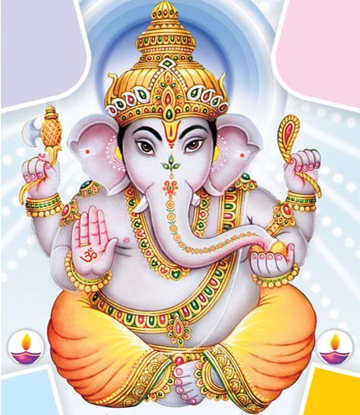
Ganesha

Slide 13
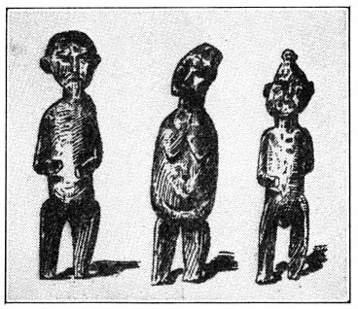
Voodoo deities
Ganesha

Slide 14
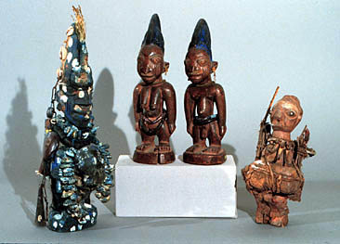
Voodoo deities
Ganesha
African deities

Slide 15
Voodoo deities
Ganesha
African deities

Slide 16
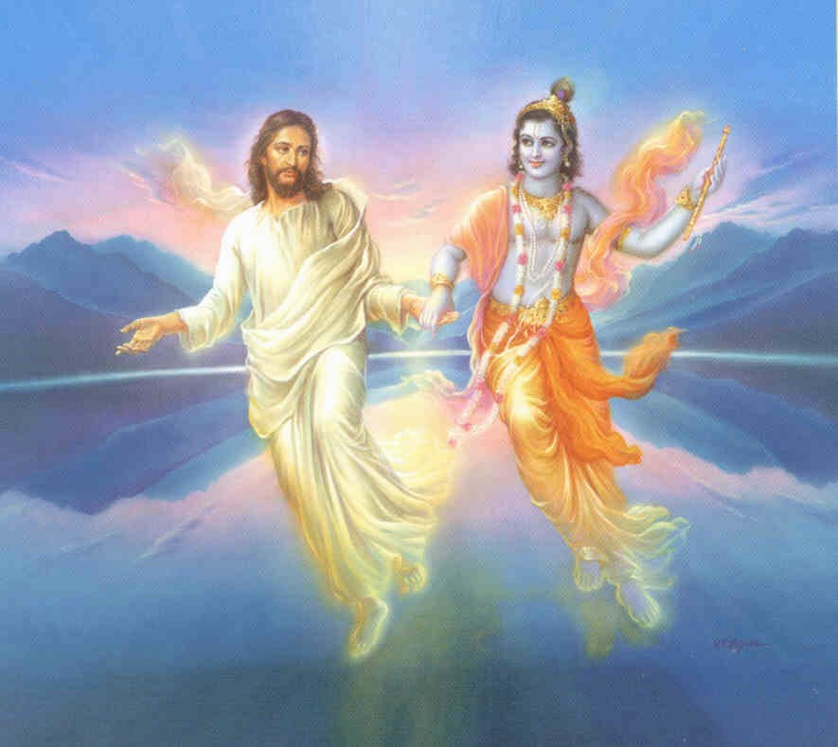
Why should your god be any better than the others?

Slide 17
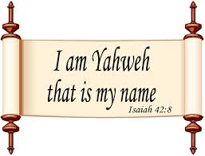
Christians and Jews worship the deity Yahweh.

Slide 19
Religious beliefs are simply a form of cultural superstition!

Slide 20
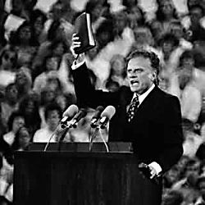
All religions are forms of superstition, based upon the erroneous belief in the existence of supernatural beings!

Slide 21
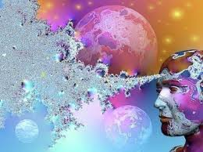
Beliefs in gods and spirits was a creation of human imagination

Slide 22
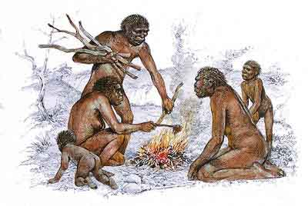
Evidence suggests that early humans created superstition and religious beliefs to cope with fears and feelings of insecurity.

Slide 23
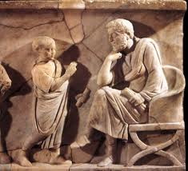
,“Fear first made gods in the world.”
Publius Statius, 45-96 AD; Thebaid, book 3, line 661.

Slide 24
“Religion evolved as a means of providing humans with a sense of security, rather than as a search for truth.”
Bishop Spong

Slide 25
Definitions:
Superstition: An extreme credulous belief in, and reverence for, supernatural beings.
Religion: The belief in. and worship of, a superhuman controlling power, especially a personal god, or gods

Slide 26
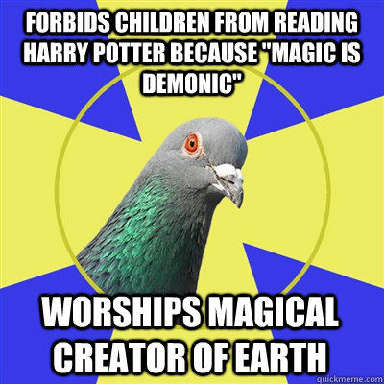
Differences?

Slide 27
There is none!

Slide 28
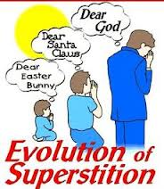
Belief in Yahweh is a superstition inherited via our Western culture.

Slide 29
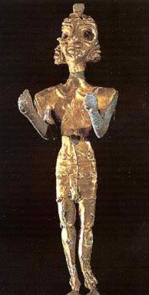
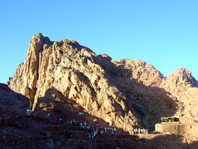
Around 1.500 BCE the Israelites, nomadic shepherds, adopted the Baal of Mount Sinai as their supreme deity.

Slide 30
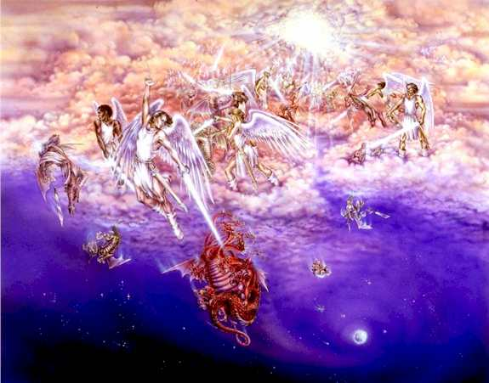
Polytheism:

Slide 31
“Then God said, "Let us make man in our image, after our likeness; … “
Genesis 1:26

Slide 32
The Israelites were scientifically illiterate

Slide 33
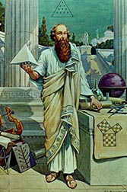
They never made any contributions to science

Slide 34
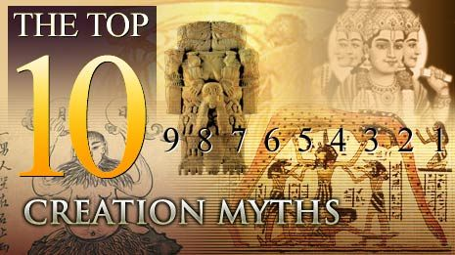
They purloined their ideas about creation and the Cosmos from the Egyptians and Babylonians.

Slide 35
“The earth was without form and void, and darkness was upon the face of the deep; and the Spirit of God was moving over the face of the waters.”
Genesis 1:2

Slide 36
“The earth was without form and void, and darkness was upon the face of the deep; and the Spirit of God was moving over the face of the waters.”
Genesis 1:2
Based upon Egyptian myth…

Slide 37
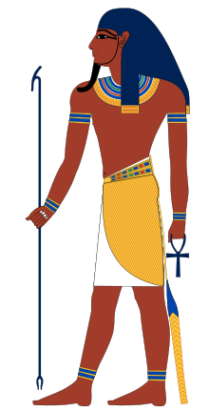
“In the beginning there was only the swirling watery chaos. Out of the chaotic waters arose Atum, who, finding no place on which to stand, created a hill (the land). ”
Egyptian creation myth

Slide 38
Science and reason involves asking questions about nature and finding the answers to those questions.

Slide 39
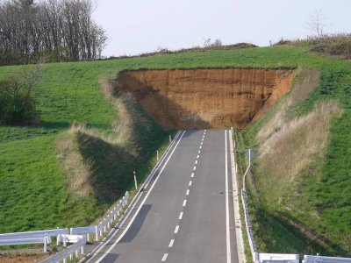

Slide 40
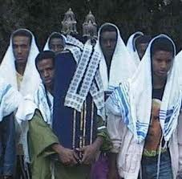
For every question about nature, the Israelites had only one answer…

Slide 41
An answer which precludes scientific investigation

Slide 42
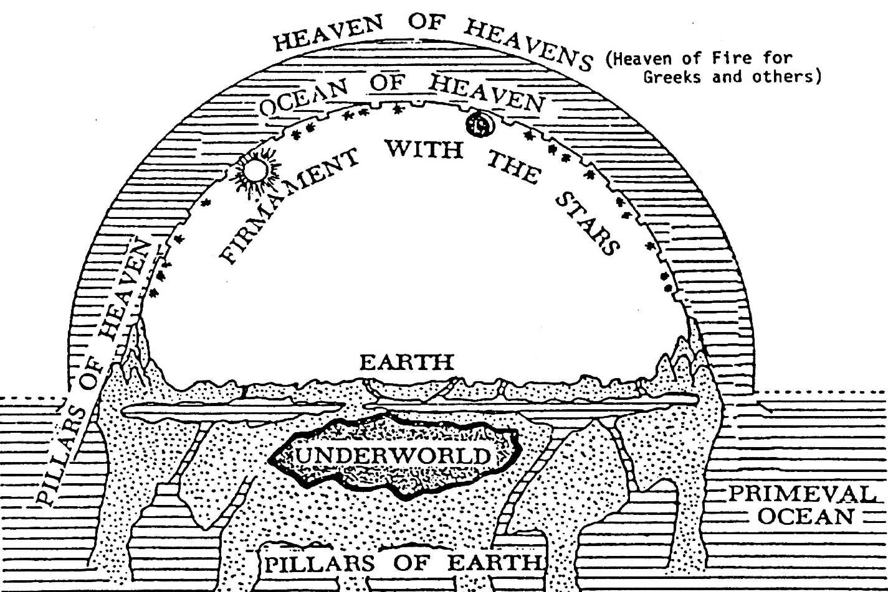
Israelites believed god had created the cosmos as a complete and perfect system

Slide 43
That meant the cosmos was “fixed” – completely static and unchanging!

Slide 44
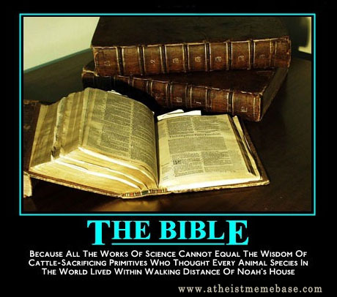
Christianity inherited the primitive beliefs of the Israelites …

Slide 45
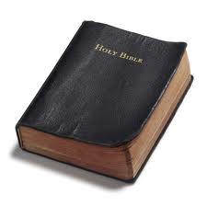
Christian belief in god is based upon what is written in the Bible,

Slide 46
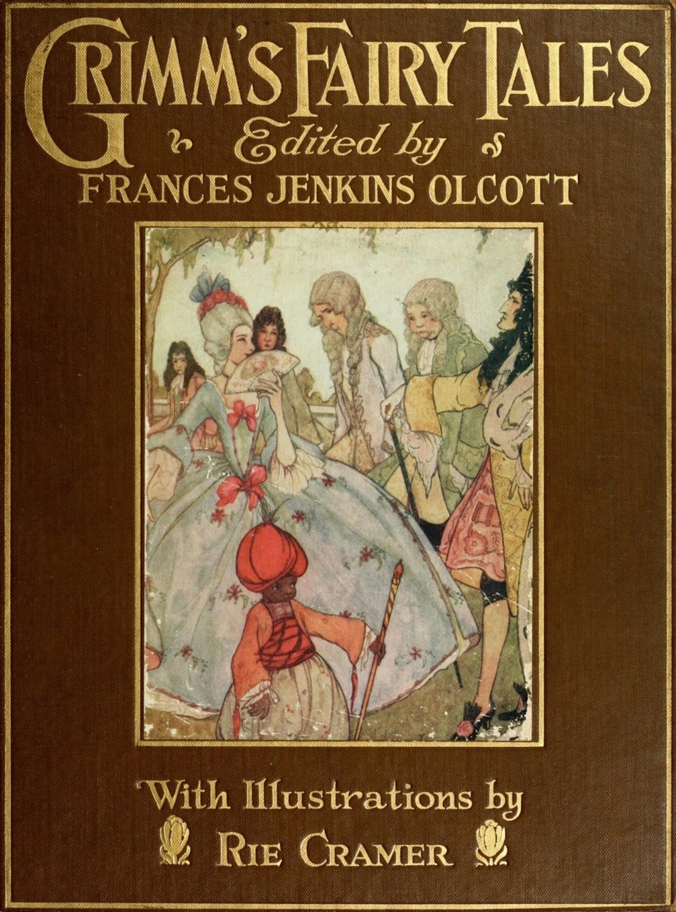
… a book of fairy-tales!

Slide 47
How reliable is the Bible?

Slide 48
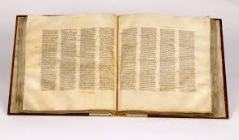
Codex Sinaiticus – 4th century - one of the earliest versions of the Bible ...

Slide 49
… contains some 23,000 textual errors in its 800 pages.

Slide 50
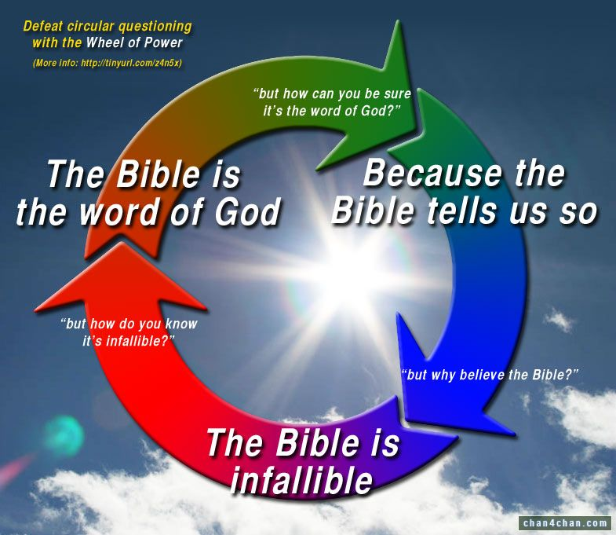
Reconciling the Bible with science requires suspension of all logical thought processes!

Slide 51
God creates light on the first day of creation, (Genesis. 1:3), but the Sun is not created until the fourth day.

Slide 52
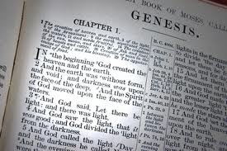
Ages of Creation

Slide 53
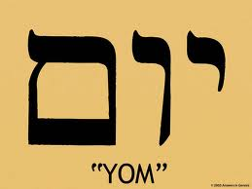
^{Yom}

Slide 54
And there was evening and there was morning, one day. Genesis 1:5
This clearly means a day of 24 hours

Slide 55
Religious beliefs based upon Ignorance

Slide 56
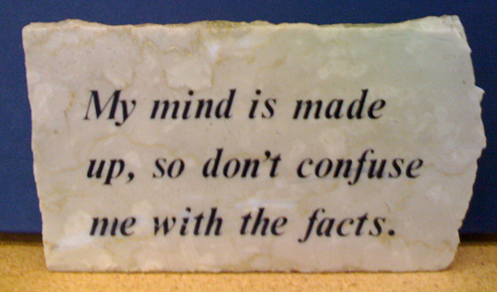
Don’t ask questions…

Slide 57
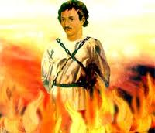
Giordano Bruno (1548-1600); dared to claim there might be an infinite number of inhabited worlds and that space may be infinite.

Slide 58
The Lost Easter

Slide 59
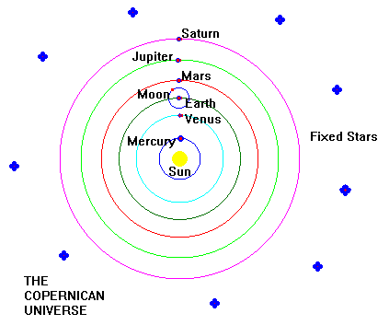

Slide 60
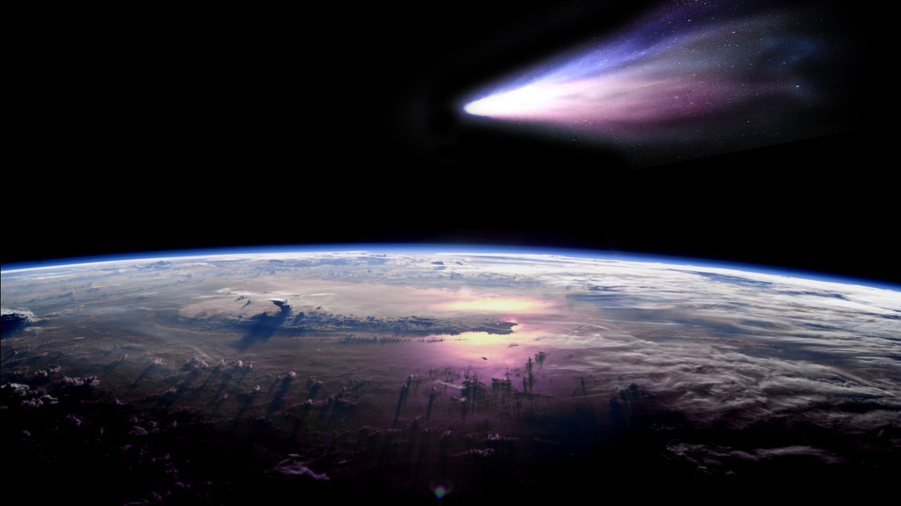
William Whiston (1667 – 1752), “Natural Theology”

Slide 61
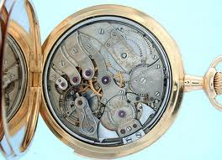
The Watchmaker analogy – William Paley 1802

Slide 62
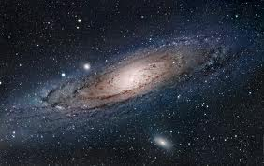
The inference being, that something as complex as the cosmos must also have been conceived and created by some great intelligence!

Slide 63
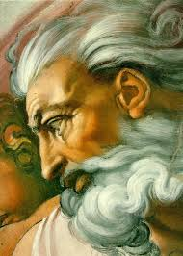
An erroneous (creationist) assumption, this remained one of the basic arguments for the existence of god until the mid-20th century

Slide 64
Miller and Urey experiment, 1952

Slide 65
“God is dead! Nietzsche didn’t kill him, it was Carl Sagan and Stephen Hawking!”
G.F. Pafumi

Slide 66
You need to believe; I don’t!

Slide 70
A

