Slide 1
The Ontological Argument
Kevin Rogers

Slide 2
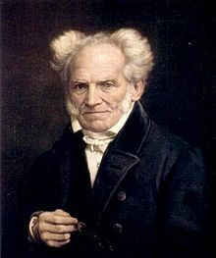
Arthur Schopenhauer (1788 – 1860)
German Philosopher
View of OA:
Sleight of hand trick
Charming joke

Slide 3
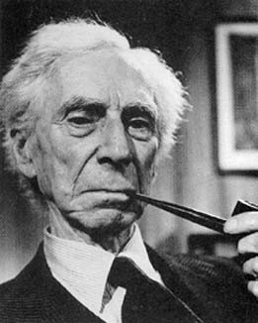
Bertrand Russell (1872 – 1970)
“It is much easier to be persuaded that ontological arguments are no good than it is to say exactly what is wrong with them”

Slide 4
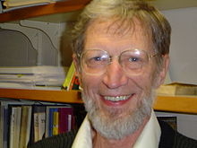
Alvin Plantinga (1932 - )
Former president of American Philosophical Association:
Although the [ontological] argument certainly looks at first sight as if it ought to be unsound, it is profoundly difficult to say what, exactly, is wrong with it. Indeed, I do not believe that any philosopher has ever given a cogent and conclusive refutation of the ontological argument in its various forms.

Slide 5
Arguments for Existence of God
Cosmological (1st cause) and Teleological (Design) arguments:
Depend on observations about the actual world
Been around since Plato and Aristotle
Some basis in Bible (Romans 1)
Ontological Argument
Nearly pure logical argument
No reference to actual world
Invented in 11th century

Slide 6
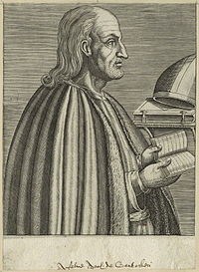
St Anselm of Canterbury (1033 – 1109)
Benedictine monk
Archbishop of Canterbury (1093 – 1109)
Originator of the ontological argument
Proslogion (1078) = Discourse on the Existence of God

Slide 7
Anselm’s Argument
Hence, even the fool is convinced that something exists in the understanding, at least, than which nothing greater can be conceived. For, when he hears of this, he understands it. And whatever is understood, exists in the understanding. And assuredly that, than which nothing greater can be conceived, cannot exist in the understanding alone. For, suppose it exists in the understanding alone: then it can be conceived to exist in reality; which is greater. Therefore, if that, than which nothing greater can be conceived, exists in the understanding alone, the very being, than which nothing greater can be conceived, is one, than which a greater can be conceived. But obviously this is impossible. Hence, there is no doubt that there exists a being than which nothing greater can be conceived, and it exists both in the understanding and in reality.
(Proslogion chapter 2)

Slide 8
Simple Version
If "that than which nothing greater can be conceived" existed only in the intellect, it would not be "that than which nothing greater can be conceived", since it can be thought to exist in reality, which is greater
It follows that "that than which nothing greater can be conceived" must exist in reality

Slide 9
Plantinga’s Summary of Anselm’s Argument
God is defined as the greatest conceivable being
To exist is greater than to not exist
If God does not exist then we can conceive of a greater being that does exist
Thus if God does not exist then he is not the greatest conceivable being
This leads to a contradiction
Therefore God must exist

Slide 10
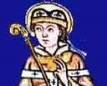
Gaunilo of Marmoutiers
11th-century Benedictine monk
In Behalf of the Fool
Refutes Anselm using a parody
The Lost Island is that than which no greater can be conceived
It is greater to exist in reality than merely as an idea
If the Lost Island does not exist, one can conceive of an even greater island, i.e., one that does exist
Therefore, the Lost Island exists in reality
No intrinsic maximum for the greatest conceivable island
Is “a greatest conceivable island” a coherent concept?

Slide 11
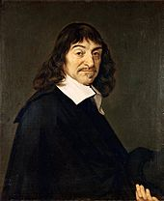
Rene Descartes (1596 – 1650)
Father of Rationalism’
Introduced the idea that existence is a perfection
The more you ponder the nature of God, the more it becomes evident to the intuition that God must exist

Slide 12
Rene Descartes (1596 – 1650)
God is a supremely perfect being, holding all perfections
Existence is a perfection
It would be more perfect to exist than not to exist
If the notion of God did not include existence, it would not be supremely perfect, as it would be lacking a perfection
Consequently, the notion of a supremely perfect God who does not exist is unintelligible
Therefore, according to his nature, God must exist

Slide 13
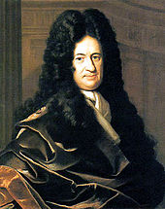
Gottfried Leibniz (1646 – 1716)
Descartes’ argument fails unless Supremely perfect being is
Coherent
Possible
Impossible to demonstrate perfections are incompatible
Forerunner of modal logic and Modal Ontological Argument.

Slide 14
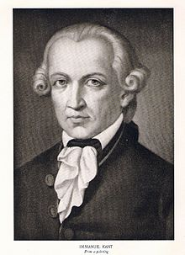
Immanuel Kant (1724 – 1804)
Enlightenment Philosopher
Unite empiricism and rationalism (Critique of Pure Reason)
Critiqued:
Ontological argument
Cosmological argument
Teleological (Design) argument
Theist (moral argument)

Slide 15
Kant’s Critique of OA
3 Claims
Existence is not a predicate
How can a conceptual conundrum in the mind affect a being’s objective existence?
Negation does not entail a contradiction

Slide 16
Existence is not a predicate
Proposition = subject + predicate, eg
A dog has 4 legs
God exists
Predicate contains properties of object
Existence
is an instantiation of an object
is not a property
is not a perfection
Undermine Descartes’ version:
Existence is a perfection:
It would be more perfect to exist than not to exist.

Slide 17
Conceptual Conundrum
Anselm argues for concepts in our minds to the objective existence of God
How can a conceptual conundrum in the mind affect a being’s objective existence?

Slide 18
Negation is not a Contradiction
Some statements are necessarily true, eg:
All bachelors are unmarried
All squares have 4 sides
Their negation entails a contradiction
“God does not exist” does not entail a contradiction
Thus “God exists” is not a necessary truth
Confuses “necessary truth” with “necessary being”

Slide 19
Kant’s Conclusion
[The Ontological Argument] “neither satisfies the healthy common sense of humanity, nor sustains the scientific examination of the philosopher."

Slide 20
Discussion and Break
What do you think so far?

Slide 21
Plantinga’s comment on Predicate Argument
Kant's point, then, is that one cannot define things into existence because existence is not a real property or predicate in the explained sense. If this is what he means, he's certainly right. But is it relevant to the ontological argument? Couldn't Anselm thank Kant for this interesting point and proceed merrily on his way? Where did he try to define God into being by adding existence to a list of properties that defined some concept?
If this were Anselm's procedure -- if he had simply added existence to a concept that has application contingently if at all -- then indeed his argument would be subject to the Kantian criticism. But he didn't, and it isn't. The usual criticisms of Anselm's argument, then, leave much to be desired.

Slide 22
Modal Ontological Argument
Developed by Plantinga
Based on modal logic
Modal logic is an extension of philosophical logic to deal with possibility and necessity
God is defined as a Maximally Great Being (MGB)
One property of God is that He exists necessarily

Slide 23
The Argument
It is possible that an MGB exists
If it is possible that an MGB exists, then an MGB exists in some possible world
If an MGB exists in some possible world, then an MGB exists in every possible world
If an MGB exists in every possible world then an MGB exists in the actual world
Therefore an MGB exists

Slide 24
Explanation
A possible world is any possible combination of state of affairs
Most people are initially puzzled by premise 3:
If an MGB exists in some possible world, then an MGB exists in every possible world
One property of an MGB is that an MGB is a necessary being – therefore must exist in all possible worlds
According to Craig only premise 1 is controversial

Slide 25
Meaning of possible
“Possible” means “metaphysically possible” rather than “epistemically possible”
Sound confusing?
Metaphysically possible means “is it actually logically possible?”
Epistemically possible relates to our knowledge: “Gee, I dunno, therefore I guess it’s possible”
Possibility is not an appeal to ignorance

Slide 26
Types of Existence
Impossible
Contingent
Necessary

Slide 27
Objections
Parodies
An MGB is incoherent (impossible)

Slide 28
Parodies
Parodies are not really an argument
Parodies are attempts to use parallel arguments to prove the existence of things we don’t believe in
On close examination the argument does not work for the parodies

Slide 29
Necessarily Existent Pink Unicorn
Argument:
It is possible that a Necessarily Existent Pink Unicorn (NEPU) exists
If it is possible that a NEPU exists, then a NEPU exists in some possible world
If a NEPU exists in some possible world, then a NEPU exists in every possible world
If a NEPU exists in every possible world then a NEPU exists in the actual world
Therefore a NEPU exists
Counter argument
A pink unicorn is physical
All physical objects/beings are contingent
Therefore a pink unicorn cannot be a necessary being
Therefore premise 1 fails

Slide 30
Reverse Ontological Argument
Reverse OA
It is possible that an MGB does not exist
If it is possible that an MGB does not exist, then an MGB does not exist in some possible world
If an MGB does not exist in some possible world, then an MGB does not exist in every possible world
If an MGB does not exist in every possible world then an MGB does not exist in the actual world
Therefore Maximal Greatness is impossible
Counter Arguments
Premise 1 is tantamount to saying that it is not possible that an MGB exists. Thus it assumes its conclusion
Likewise for premise 2

Slide 31
Dawkins’ Ontological Argument
Argument
The creation of the world is the most marvellous achievement imaginable.
The merit of an achievement is the product of (a) its intrinsic quality, and (b) the ability of its creator.
The greater the disability (or handicap) of the creator, the more impressive the achievement.
The most formidable handicap for a creator would be non-existence.
Therefore if we suppose that the universe is the product of an existent creator we can conceive a greater being namely, one who created everything while not existing.
An existing God therefore would not be a being greater than which a greater cannot be conceived because an even more formidable and incredible creator would be a God which did not exist.
Therefore, God does not exist.
Objection : It is incoherent to propose creation by a God who does not exist

Slide 32
MGB is Incoherent
These are versions that claim that it is not possible that an MGB exists
Omnipotence Paradox
Problem of Evil

Slide 33
Essence of Argument
If it is possible that a Necessary Being (NB) exists then that NB must exist in all possible worlds

Slide 34
Debate between Craig and Victor Stenger
Craig used MOA in debate with Stenger
Stenger attempted a parody (maximally great pizza)

Slide 35
Practical Use of OA
I have heard it claimed that no-one has ever been converted by the OA – not actually true
God is defined as a Maximally Great Perfect Being – solution to Euthyphro Dillemma

Slide 36
What do you think?

