Slide 1
Arguments for the existence of God
Cosmological argument
Teleological argument
Moral argument
Resurrection
Personal Experience
Notes:
Ok

Slide 2
Kalam Cosmological Argument
The argument:
Everything that begins to exist has a cause
The universe began to exist
Therefore the universe has a cause
What are the properties of this cause?
Premise 1 considered intuitively obvious
Historically atheists have claimed that the universe is eternal and uncaused
Most effort went into justifying premise 2
Al-Ghazali argued that an infinite sequence of causes cannot exist – therefore the universe must have a beginning
Notes:
Picture of Al Gahazali

Slide 3
Arguments for a Beginning
Two types of argument
Philosophical
Scientific

Slide 4
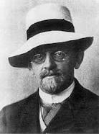
Philosophical Arguments for Beginning
A universe without a beginning requires an infinite sequence of causes
Cannot form an infinite by successive addition
Actual infinites lead to absurdities (Hilbert’s Hotel)
David Hilbert (1862-1943):
Infinites are only a concept in the mind
Infinites occur nowhere in reality
People confuse big numbers with the infinite numbers
The universe is very big, but not infinitely big
It is finite in matter, energy, space and time

Slide 5
Scientific Reasons for a beginning
Today, premise 2 is generally accepted for scientific reasons:
Second law of thermodynamics
Entropy constantly increasing
Why are the stars still burning?
Big Bang theory
Universe constantly expanding
Began from a singularity a finite time ago
Standard Model: the singularity marked the beginning of:
Matter
Energy
Space
Time

Slide 6
Alternatives?
Infinite sequence of universes?
Speculative
No evidence
Unobservable
Un-testable
Cannot be past eternal
Closed off by Borde, Guth & Vilenkin Theorem (2006)

Slide 7
Current Status
Today, premise 2 is generally accepted for scientific reasons:
Premise 1 (Everything that begins to exist has a cause) is challenged today
Some atheists claim the universe popped into existence uncaused out of nothing
Smoke and mirrors
Redefine nothing to be something
“Nothing comes from nothing. Nothing ever will” (The Sound of Music)

Slide 8
Common Objection
If God made the universe, then who made God?
Answer:
No one. God is eternal and has no beginning. God was not made or created and is uncaused.
The argument can be stated crudely :
There must be something that is eternal and uncaused – otherwise we would not be here
That something must be either the universe or God
It is not the universe
Therefore it must be God

Slide 9
The Nature of the Cause
The start of the universe marked the beginning of energy, matter, space and time
Thus the cause of the universe must possess the following properties:
Transcendent:
Non-physical
Timeless
Spaceless
Powerful
Personal (makes decisions)

Slide 10
Fine Tuning Argument
Scientists used to believe evolution of life was inevitable
Discoveries in last 40 years have shown this to be wrong
Initial conditions of universe and physical constants are extraordinarily finely tuned to enable any possible form of life

Slide 11
Initial Conditions
Examples of initial conditions:
Rate of expansion of universe
Mass density of universe
Balance between matter and anti-matter

Slide 12
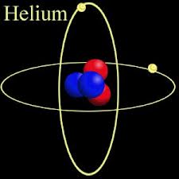
Example - Formation of elements
Atomic nuclei consist of protons and neutrons
Protons repel each other
Strong nuclear force (gs) binds nuclei
If gs 2% stronger, no hydrogen
No water, no hydrocarbons, no life
If gs 2% weaker, only hydrogen
No other elements, no life
Critical for formation of atomic table
No Darwinian explanation

Slide 13
Fine Tuning
“Goldilocks Effect” - The universe is just right to permit life.
About 12 physical constants and 12 initial conditions are finely tuned to enable the universe to be life permitting
Notes:
Speak to original 1st point (last 50 years)

Slide 14
Examples of Numbers
1,000,000 = 10⁶
The universe is claimed to be 10¹⁷ seconds old
There are 10⁸⁰ atoms in known universe
Alteration of weak force constant (gw) by 1 in 10¹⁰⁰ would prevent life
Alteration of cosmological constant (Λ) by 1 in 10¹²⁰ would prevent life
Probability of low entropy beginning of universe is 1 in W. W is Penrose number = 1 followed by 10¹²³ zeros.

Slide 15
Fine Tuning Argument
The fine tuning of the constants in the laws of physics and the Big Bang initial conditions are due to Law, Chance or Design.
The fine tuning is not due to Law or Chance.
Therefore it is due to design.

Slide 16
Multi-verse Theory
Current state of play:
The universe was designed by a Designer, or
There are an infinite number of universes with random physical laws and we happen to live in a lucky one
Multiple universes cannot be observed or tested
Multi-verse must be finely tuned
If there are multi-verses, we would not expect to see the universe that we do
Other configurations are far more probable
Which option is more plausible?

Slide 17
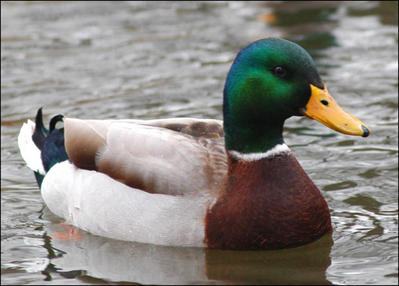
The Duck Test
Dawkins refers to “the illusion of design”, but...
If it looks like a duck, swims like a duck, waddles like a duck and quacks like a duck, then perhaps it is a duck.

Slide 18
Designer Properties
Highly intelligent
Has a mind

Slide 19
Moral Argument
The cosmological and teleological arguments claim that there is a Creator and Designer of the universe
Is He interested in us?
Deism: God is not interested in us
Theism: God is interested in us
The moral argument implies that God is interested in us
Moral argument does not claim that atheists are immoral
We are all moral, but why?
Notes:
State that moral argument shows that God is interested in us.

Slide 20
Moral Argument
Moral argument:
If God does not exist then objective moral values do not exist
Objective moral values do exist
Therefore God exists
What are Objective moral values?
Objective moral values are valid and binding whether people believe them or not
Relative moral values are matter of personal taste
Atheism implies that there is no basis for objective moral values.

Slide 21
Premise 1
If God does not exist then objective moral values do not exist
This admitted to be true by atheists

Slide 22
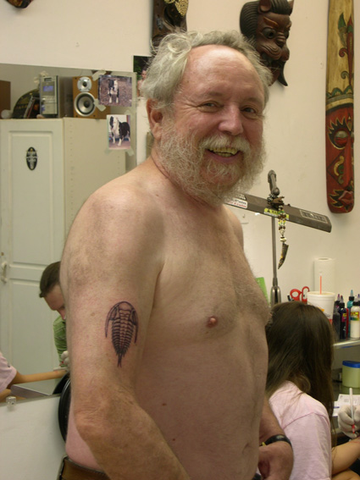
Michael Ruse
The position of the modern evolutionist is that human beings have an awareness of morality, because such an awareness is of biological worth. Morality is a biological adaptation no less than are hands and feet and teeth. Considered as a rationally set of justifiable claims about an objective something, ethics is illusory. I appreciate that when somebody says “Love thy neighbor as thyself”, they think they are referring above and beyond themselves. Nevertheless, such reference is truly without foundation. Morality is just an aid to survival and reproduction, and any deeper meaning is illusory.

Slide 23
2nd Premise
If Moral values and duties are not objective then
They are just a matter of opinion
We have no right to judges others actions
Morality is not binding... but
People only maintain that moral values are relative until faced with examples
Was the holocaust evil regardless of who won the war?
Is paedophilia Ok? Paedophiles think it is Ok.
Is raping babies Ok?
Most people will recoil in horror.
As soon as we admit that raping babies is objectively bad then we affirm that objective moral values do exist
Notes:
Speak to original 1st point. Matt has some doubts on mentioning raping babies.

Slide 24
Implications
Moral argument affirms that God is interested in our values and what we do
We now affirm belief in a God who is interested in us

Slide 25
God in History
In the past God spoke to our forefathers through the prophets at many times and in various ways, but in these last days he has spoken to us by his Son (Hebrews 1:1)
God is there and He has spoken (Francis Schaefer)

Slide 26
Widely Accepted Facts
Historians take the NT seriously as a source of historical information about Ancient Near East
General agreement by historians on following historical facts
Jesus was crucified, died and was buried by Joseph of Arimathea
On the Sunday morning his tomb was empty
The disciples believed they saw appearances of the risen Christ
The origin of the early church was based on the belief in the resurrection

Slide 27
Attempted Explanations
Naturalistic Hypotheses
Conspiracy
Apparent Death
Displaced Body
Hallucination
None of these explain the evidence
The NT claim that God raised Jesus from the dead does explain the evidence
Divine miracle on our hands
Therefore God exists

Slide 28
Personal Experience
As a philosophy, it works
God can also be personally known
Knowledge is accessible to ordinary people
My experience
If you seek God, you will find him if you search for him with all your heart (Jeremiah 29:13)

Slide 29
Summary
Atheism versus theism

Slide 30
Atheism
No viable explanation for origin of universe
Unintuitive and incomplete account for design
A naturalistic account implies denial of
Freedom of the will
Human responsibility
Reliability of human thought
Reality of human consciousness
First of all man lost his soul, then he lost his mind, then he lost consciousness
Loss of meaning and purpose
Atheism logically forces us to deny what we intuitively know to be true

Slide 31
Theism
Theism has greater explanatory power:
Creation of universe out of nothing
Design in the universe
Basis for objective morality and human value
Reality of
Consciousness
Human thought
Freedom of the will
Human responsibility
Provides meaning, purpose and eternal destiny

Slide 32
Ontological Argument
A completely logic argument with no reference to the external world
If it is possible that God exists, then God must exist.
Two forms:
Anselm (1033 – 1099)
Alvin Plantinga (1932 - )

Slide 33
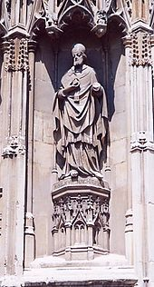
Anselm’s Version
God is the greatest conceivable being
To exist is greater than to not exist.
If God does not exist then it is possible to conceive a greater being
Therefore God exists

Slide 34
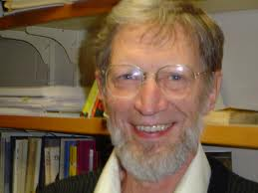
Plantinga’s Version (simplified)
Argument:
It is possible that a Maximally Great Perfect Being (MGPB) exists.
If it is possible that a MGPB exists then he must exist in some possible world.
If he exists in some possible world then he must exist in all possible worlds
Therefore a MGPB exists
Only premise 1 is controversial

Slide 35
Essence of OA
One of the properties of an MGB is necessary existence
If it is possible that a necessary being exists then a necessary being must exist.

Slide 36
Euthyphro Dilemma
Is an act right because God says it's so, or does God say it's so because it's right?
False Dilemma
God is maximally perfect
Goodness is the expression of God’s character
Good and evil are not equivalent
Evil is essentially parasitic on the good
The good is living functionally in God’s creation
So God knows what is good

Slide 37
Problem of evil
Acknowledges objective reality of good and evil and thus reinforces 2nd premise in moral argument (objective moral values and duties exist)

Slide 38
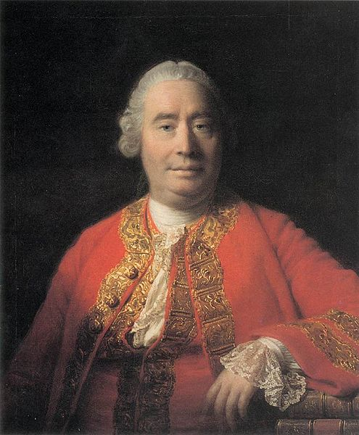
David Hume’s Formulation
Is God willing to prevent evil, but not able?
Then is he impotent.
Is he able, but not willing?
Then is he malevolent.
Is he both able and willing?
Whence then is evil?”

Slide 39
Response to Hume
Neither of Hume’s 1st 2 premises are necessarily true

Slide 40
Premise 1
Is God willing to prevent evil, but not able?
Then is he impotent.
Alvin Plantinga’s free will argument
God is not able to do the logically impossible
Human freedom may be incompatible with prevention of evil
Would we want our children to be perfect robots?

Slide 41
Premise 2
Is he able, but not willing?
Then is he malevolent
God may have a purpose in allowing pain, suffering or evil
Happiness drug

Slide 42
Christian Framework
Freedom and fall
Most of our suffering is due to our own choices
This life is not all there is
Suffering is a means of growth in maturity
Final judgement will resolve all

